Slide 1
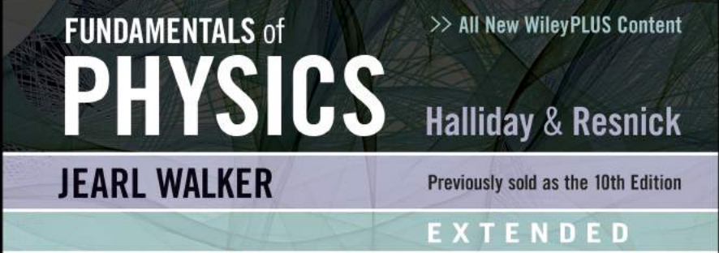
Course Title | Applied Physics | Course Code | NS1001
RIMSHA Bashir Awan
Email: rimsha.bashir@nu.edu.pk
FAST-National University of Computer and Emerging Sciences

Slide 2
Text Book(s) | Title | Halliday & Resnick Fundamentals of Physics (Extended 11th Edition)
 | Author(s) | Jearl Walker
 | Publisher | © 2013 by John Wiley & Sons Inc.
Ref. Book(s) | Title | Physics for Scientists and Engineers with Modern Physics (6th Edition)
 | Author(s) | Raymond A. Serway & John W. Jewett
 | Publisher | © 2004 Thomson books/cole US
 | Title | Physics for Scientists and Engineers (6th Edition)
 | Author(s) | Paul A Tipler and Gene Mosca
 | Publisher | W.H. Freeman and Company
 | Title | Physics for Scientists and Engineers (3rd Edition)
 | Author(s) | Fishbane, Gasiorowicz, Thornton
 | Publisher | Pearson Prentice Hall
 | Title | Physics for Engineers & Scientists (3rd Edition Extended)
 | Author(s) | Hans C. Ohanian and John T. Markert
 | Publisher | W. W. Norton & Company New York. London
 | Title | MATLAB –A practical introduction to programming and problem solving (3rd Edition)
 | Author(s) | Stormy Attaway
 | Publisher | Elsevier 2013

Slide 3
Week | Course Contents/Topics | Chapter
01 | Adding Vectors, Components of Vectors, Unit Vectors, Vector & Scalar Products, Position & Displacement (2/3 dimensions), Numerical Problems | 03, 04
02 | Average/Instantaneous Velocity/Acceleration, Projectile Motion, horizontal/vertical motions | 04
03 | Projectile Motion: equation of the path, max. height, time of flight and horizontal range, Uniform Circular Motion, Numerical Problems | 04
04 | Newton Laws of Motion, Forces (1D/2D): Gravitational, Friction, Tension, Weight, Numerical Problems, MATLAB implication. | 05
05 | Simple Harmonic Motion, the Force Law for SHM, Energy in Simple Harmonic Motion, Angular SHM | 15

